Slide 1
PRIYANKA SPICE FACTORY
Presented by
PRIYANKA P - EBEON0722625966

Slide 2
HTML
HTML-Hyper Text Markup Language
HTML documents describe web pages
HTML tags are keywords surrounded by angle brackets like <html>
HTML tags normally come in pairs like<b>and</b>
The first tag in a pair is the start tag (opening tag).
The second tag is the end tag(closing tag)
Each HTML tag describes different document content.
An HTML file must have an .html file extension.

Slide 3
HTML TAGS
Tags are markers in Html documents. It indicates special types of coding that are used to specify document titles, itemized lists, create tables, format text etc.
Tags are always enclosed with less than “<“ symbol and a greater than “>” symbol.
<html></html> tags is used for HTML document.
<head></head> is used for head section.
<title></title> is used for the web page title.
<body></body> is used for body section.
<p></p> is used for paragraph tag.
<br></br> is the line break tag.

Slide 4
HTML ATTRIBUTES
Every tag can contain attributes. Attributes are used to provide additional information about HTML elements.
HTML elements can have attributes
Syntax:
Attribute name=“attribute value”
Ex:
Bgcolor=“red”
Attributes are always specified in the start tags
i.e:
<body bgcolor=“red”> starting tag
</body>

Slide 5
STEPS FOR CREATING HTML FILE
Open a text editor.(e.g. Notepad)
Create your HTML document.
Save the HTML document(extension of .html)
Display your document in WWW browser window.
Check your work and modify as necessary.
Upload it on the web.

Slide 6
BASIC STRUCTURE OF HTML
<html>
<head>
<title>Page Title</title>
</head>
<body>
<h2> Heading Content</h2>
<p>paragraph content</p>
</body>
</html>

Slide 7
CSS
CSS is a way to style HTML. Whereas the HTML is the content, the style sheet is the presentation of that document.
The property is followed by a colon(☺and the value is followed by a semicolon(;)
There are three ways to apply CSS to HTML
Inline – Affects only the element applied to
Internal – Affects only the elements in a single file.
External – Linked to an unlimited number of files.

Slide 8
APPLYING CSS
Inline:
<p style=“color:red” Hello World</p>
Internal:
<style type=“text/css”>
body{ font-family: Arial, Helvetica;
}
</style>
External:
<link rel=“stylesheet” href=“web.css”>

Slide 9
Javascript
A scripting language that works with HTML to enhance web pages and make them more interactive.
Runs in a web browser(client-side).
Embedded in HTML files and can manipulate the HTM itself.
Javascript can validate the data the user enters into the form, before it is sent to your web Application.

Slide 10
ADD JAVASCRIPT TO HTML
In the HTML page itsef:
<html>
<head>
<script language=“javascript”>
//JavaScript code
<script>
</head>
As a file, linked from the HTML page
<head>
<script language=“javascript” src=“script.js”></script>
</head>

Slide 11
DATABASE MANAGEMENT SYSTEM
A Database Management System is a collection of interrelated and persistent data to as the database.
A set of application programs used to access, update and manage the data.
It is data independence and efficient access.
It reduced application development time.
Types of DBMS
1.Relationnal database
2. Object oriented database.
3. Hierarchical database.
4.Network database.

Slide 12
TYPES OF DBMS
Relation Database:
It is a collection of information that organizes data in predefined relationships where data is stored in one or more tables.
Object –oriented database
It is database system that can work with complex data objects.
Hierarchical Database:
It is a data model in which data is stored in the form of record and organized into a tree-like structure, in while one parent node can have many child nodes connected through links.
Network Database:
The multiple member records or files can be linked to multiple owner files.

Slide 13
STRUCTURED QUERY LANGUAGE
It is use to create a database.
SQL uses certain commands like Create, Drop, Insert,etc to carry out the required tasks.
SQL Commands:
1.DDL-Data Definition Language
2.DQL- Data Query Language
3. DML-Data Manipulation Language
4. DCL-Data Control Language
5. TCL- Transaction Control Language

Slide 14
STRUCTURED QUERY LANGUAGE COMMANDS
DDL is a set of SQL commands used to create, modify, and delete database structures but not data.
List of DDL Commands: CREATE, DROP, ALTER, TRUNCATE, COMMAND, RENAME.
DQL includes the SELECT statement that allows getting the data out of the database to perform operations with is.
List of DQL Command: SELECT
DML is the component of the SQL statement that controls access to data and to the database.
List of DML Commands: INSERT, UPDATE,DELETE,LOCK

Slide 15
STRUCTURED QUERY LANGUAGE COMMANDS
DCL includes commands such as Grant and Revoke which mainly deal with the rights, permissions, and other controls of the database system.
List of DCL Commands: GRANT, REVOKE
TCL is a set of tasks into a single execution unit. Each transaction begins with a specific task and ends when all the tasks inn the group successfully complete. If any of the tasks fail, the transaction fails.
Therefore , a transaction has only two results; success or failure.
List of TCL Commands: COMMIT,ROLLBACK,SAVEPOINT,SET TRANSACTION

Slide 16
HYPERTEXT PREPROCESSOR
<?php
$n=$_POST['stname'];
$c=$_POST['stclass'];
$con=mysqli_ connect("localhost","root","","food");
$sql="INSERT INTO order(Username,password)values('$n',' $c')";
$r=mysqli_ query($con, $sql);
if($r)
{
echo "user details added successfully";
}
else {
echo "user details not added";
}
?>

Slide 17
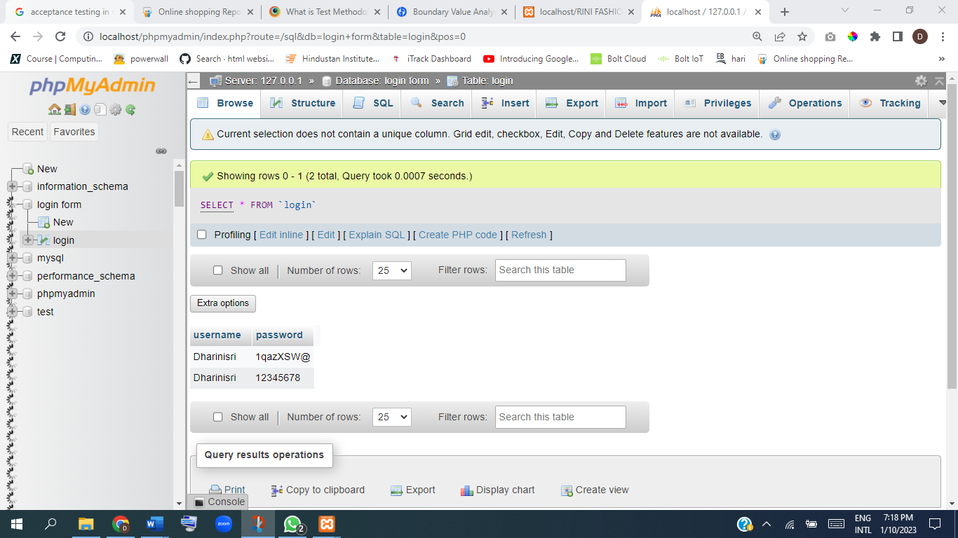
DATABASE CONNECTIVITY
Database Connection

Slide 18
SOFTWARE TESTING
Software testing is the process of evaluating and verifying that a software product or application does what it is supposed to do.
Types of Software Testing:
Unit Testing: A unit test is a way of testing a unit- the smallest piece of code that can be logically isolated in a system.
Integration Testing: It is a type of software testing in which the different units, modules or components of a software application are teste as combined entity.
System Testing: A QA team evaluate how the various components of an application interact together in the full, integrated system or application.
Acceptance Testing :It determine to what degree an application meets end users approval.

Slide 19
SOFTWARE TESTING
Software testing is the process of evaluating and verifying that a software product or application does what it is supposed to do.
Types of Software Testing:
Unit Testing: A unit test is a way of testing a unit- the smallest piece of code that can be logically isolated in a system.
Integration Testing: It is a type of software testing in which the different units, modules or components of a software application are teste as combined entity.
System Testing: A QA team evaluate how the various components of an application interact together in the full, integrated system or application.
Acceptance Testing :It determine to what degree an application meets end users approval.

Slide 20
NON FUNCTIONAL TESTING
Load testing: A type of testing to ensure that a software program or system can handle a large number of user or transactions.
Performance Testing: A type of testing to ensure that a software program or system meets specific performance goals, such as response time or throughput.
Security Testing: a type of testing to ensure that a software program or system can be scaled up or down to mett changing needs.
Usability testing: a type of testing to ensure that a softwareprogram or system is easy to use.
Volume Testing: A type of testing to ensure that a software program or system can handle a large volume of data

Slide 21
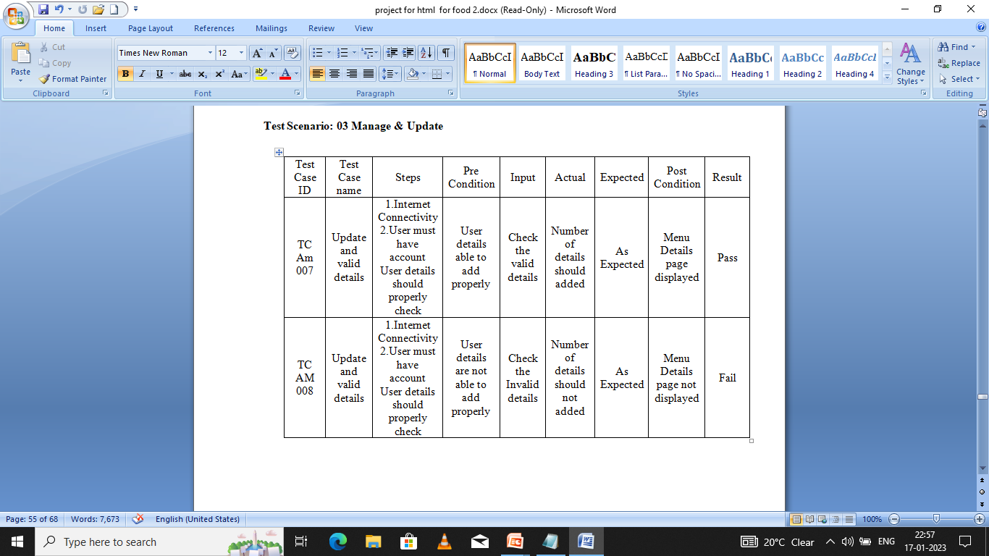
TEXT CASE REPORTS
Test case for Manage & Update

Slide 22
FEATURES OF SELENIUM
Selenium is a functional Automation tool for web Applications.
Selenium is an open source tool
Selenium supports the language like HTML Java , PHP. Perl. Python. Ruby and c#.
It supports the browsers like IE, Mozilla Firebox. Safari, Google Chrome and Opera.
It supports the operating Systems like Windows, Linux and Mac.
It is very flexible when compared to QTP and other functional tools, because it supports multiple languages.

Slide 23
TESTING WITH SELENIUM
We can perform Regression testing with selenium by writing Reusable Scripts in the form of Functions or Methods.
We can perform Retesting with looping concepts.
We can validate the application by using conditional statements.
We can perform Database testing
Reporting of the test results.
Test case grouping
Re-execution of failed test cases.

Slide 24
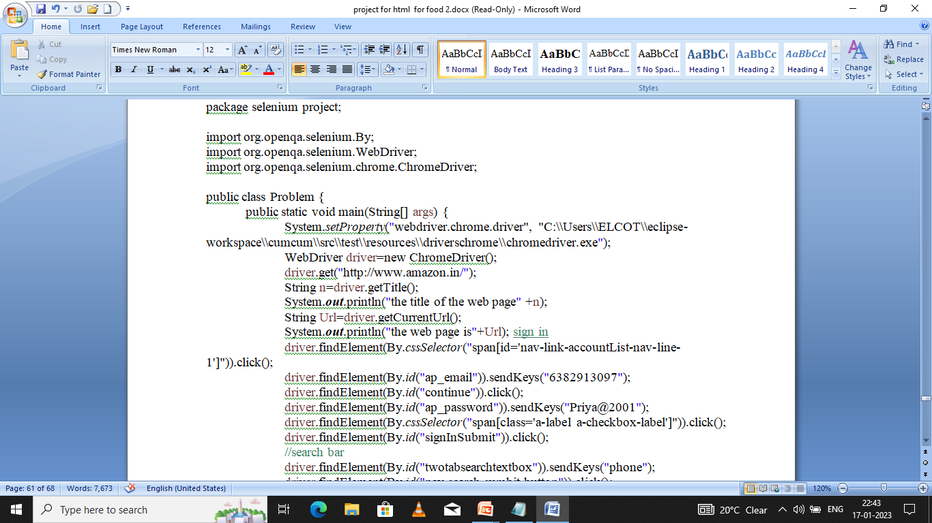
AUTOMATION TESTING
Automation Testing using amazon

Slide 25
CUCUMBER FRAMEWORK
Cucumber Framework supports BDD. Behaviour driven Development is a software development technique that has evolved from TDD, which is an approach of programming practice where the developers write new code only When the automated test case fails.
In BDD, “Given-When-Then” is the proposed approach for writing test cases.
Given the user has entered invalid credentials
When the user clicks submit button
Then display the proper validation message.

Slide 26
FEATURES OF CUCUMBER
Features of Cucumber
Feature: feature to test google functionality
Scenario: valid google search is working
Given user is on google search page
When user enters a text in box
And hits enter
Then user is navigated to the search results.

Slide 27
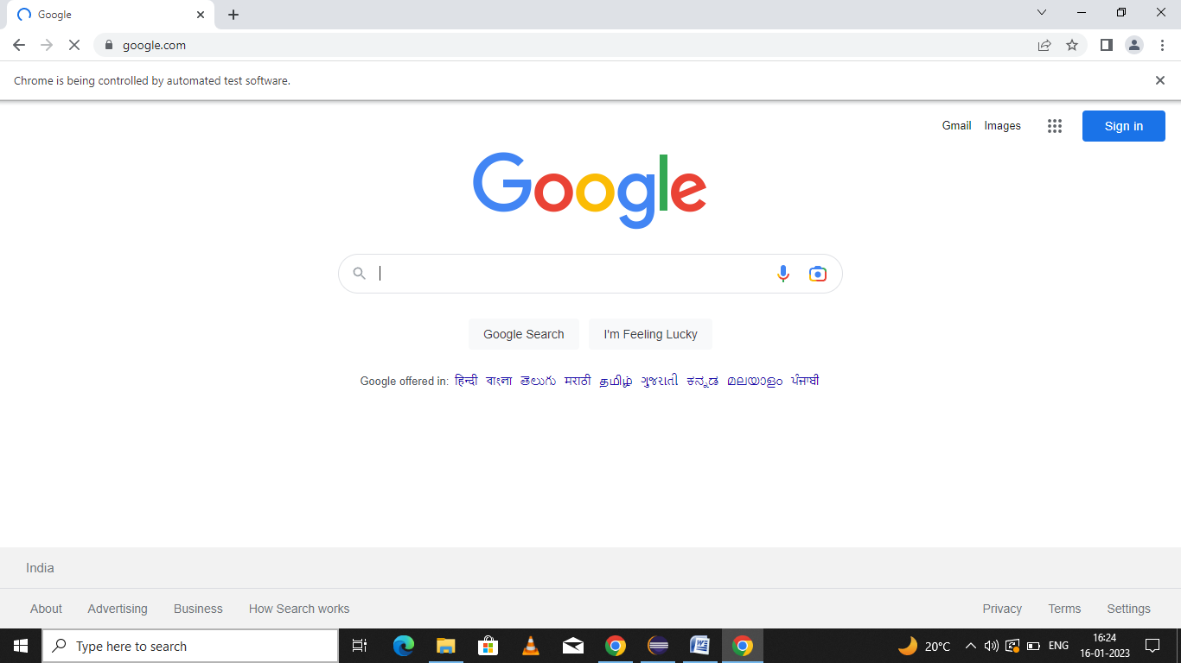
FEATURES OF CUCUMBER
Result

Slide 28
Thank you

